Slide 1
TRIES

Slide 2
Text Processing
Text processing can have multiple features according to scenario for providing ease of use for the users. For example
spell checking
commonly found in MS Word
auto correction
commonly found in MS Word
text prediction
commonly found in messaging apps

Slide 3
Text Prediction
Tries can be used for text prediction
Or we can say that tries can be used to search all the words given a prefix
What if we try to search words given a prefix using previous data structures

Slide 4
Tries
Tries are normally used for storing char data, e.g.,
dictionary
lookup
predictive text
A word in a trie is scattered as a character by character

Slide 5
So for storing a word, we need to take an array of size 26 and initially all the characters are blank as there are no words and it will look as shown below,

Slide 6
1. "hello" "hello" starts from "h", So we will mark the position "h" as filled, which represents the use of "h".

Slide 7
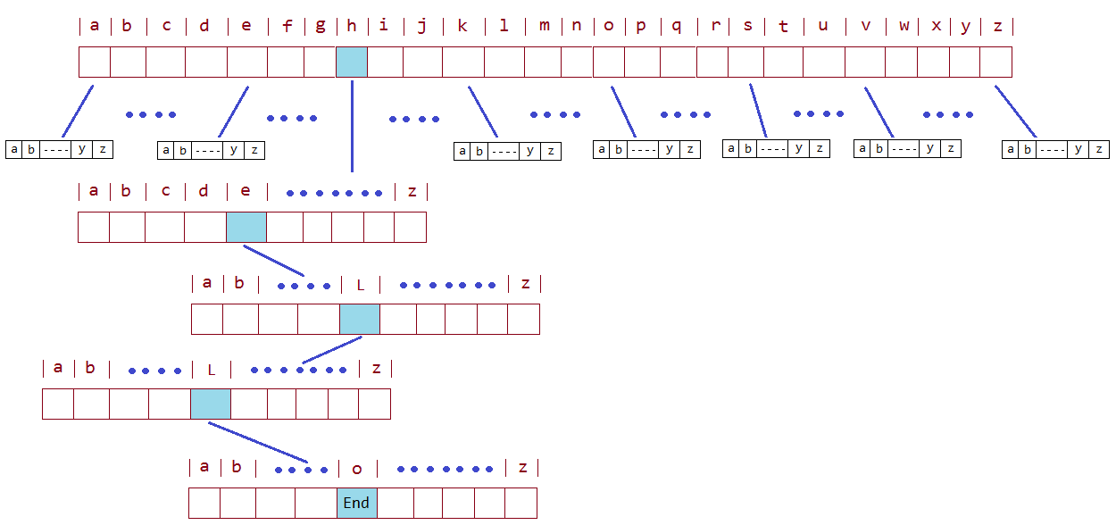
Second character is "e", So from "h", we will move to "e" and mark "e" in 2nd array as used. After "e", 3rd character is "l", So mark the position "l" as used in respective array. Repeat the above steps for all the characters of a word and Trie will look like it

Slide 8
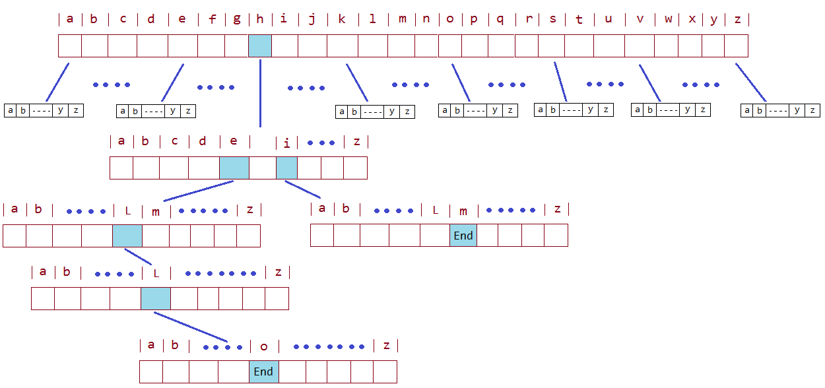
After storing "hello" and "him", Trie will look like below.

Slide 9
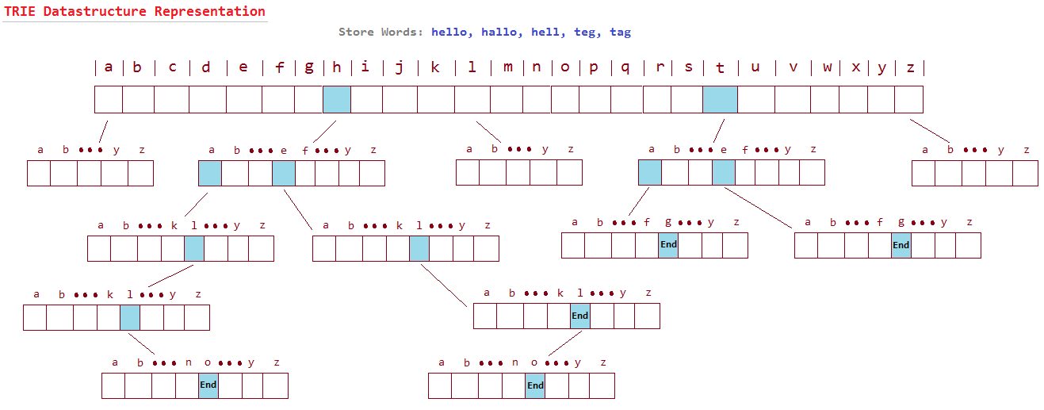
http://javabypatel.blogspot.in/2015/07/trie-datastructure-explanation-and-applications.html

Slide 10
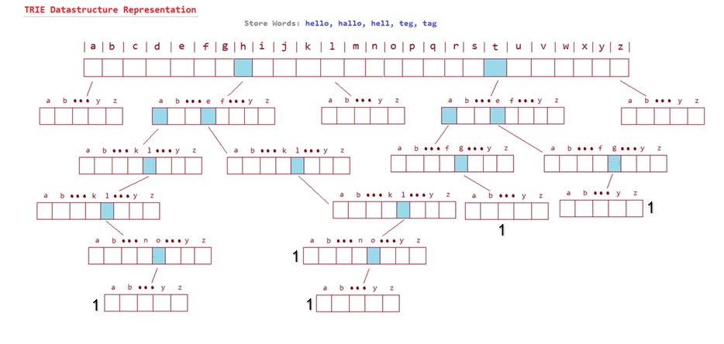

Slide 11
Analysis
O(m)
where m is length of the longest word
In BST, as we increase the data in the tree, the tree grows
whereas, this is not the case in Tries.

Slide 12
Implementation

Slide 13
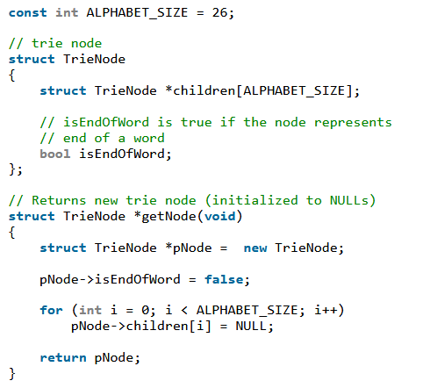
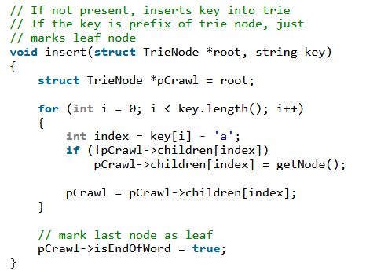

Slide 14
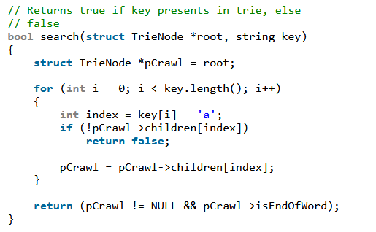
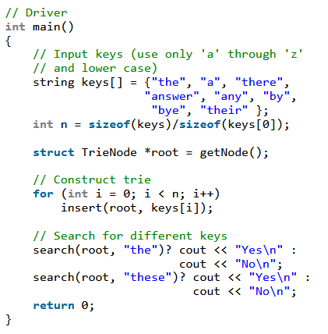
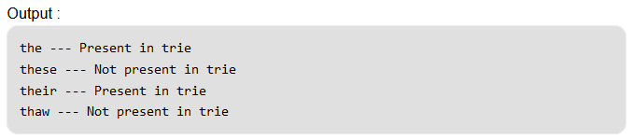

Slide 15
Reference for Code:
https://www.geeksforgeeks.org/auto-complete-feature-using-trie/

